Slide 1
GPU-Accelerated Backpropagation with C/CUDA
A presentation by Drew Hans

Slide 2
Research Question
Can a CUDA-enabled graphics processing unit (GPU) be used to reduce the time it takes to train a fully-connected three-layer artificial neural network?

Slide 3
Presentation Overview
Fundamentals of Machine Learning & Artificial Neural Networks
GPU-Accelerated Computing with CUDA
My Research Project: Neuronmancer
Project Challenges, Successes, & Results

Slide 4
Fundamentals of Machine Learning
Let’s cover the basics

Slide 5
Learning
is the process of turning
experience into knowledge.

Slide 6
3 Major Machine Learning Approaches
Supervised Learning
The output you want from the model is known.
Two subgroups:
Classification
Regression
Unsupervised Learning
The output you want from the model is not known.
One big subgroup:
Clustering
Reinforcement Learning
The model has agency, meaning it is able to interact with its environment, and receives "rewards" and "punishments" for its actions.
Examples:
Image recognition
Speech recognition
Stock price prediction
Examples:
Netflix recommendations
Medical imaging
Gene sequence analysis
Examples:
Playing Checkers
Playing Go
Robot Control

Slide 7
Artificial Neural Networks
A type of machine learning model

Slide 8
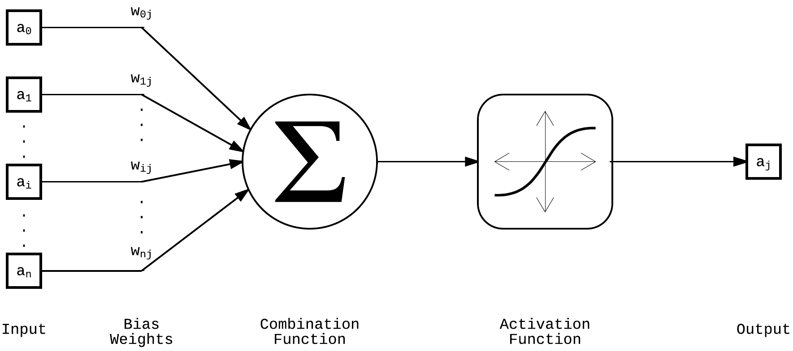
A mathematical model for a single neuron

Slide 9
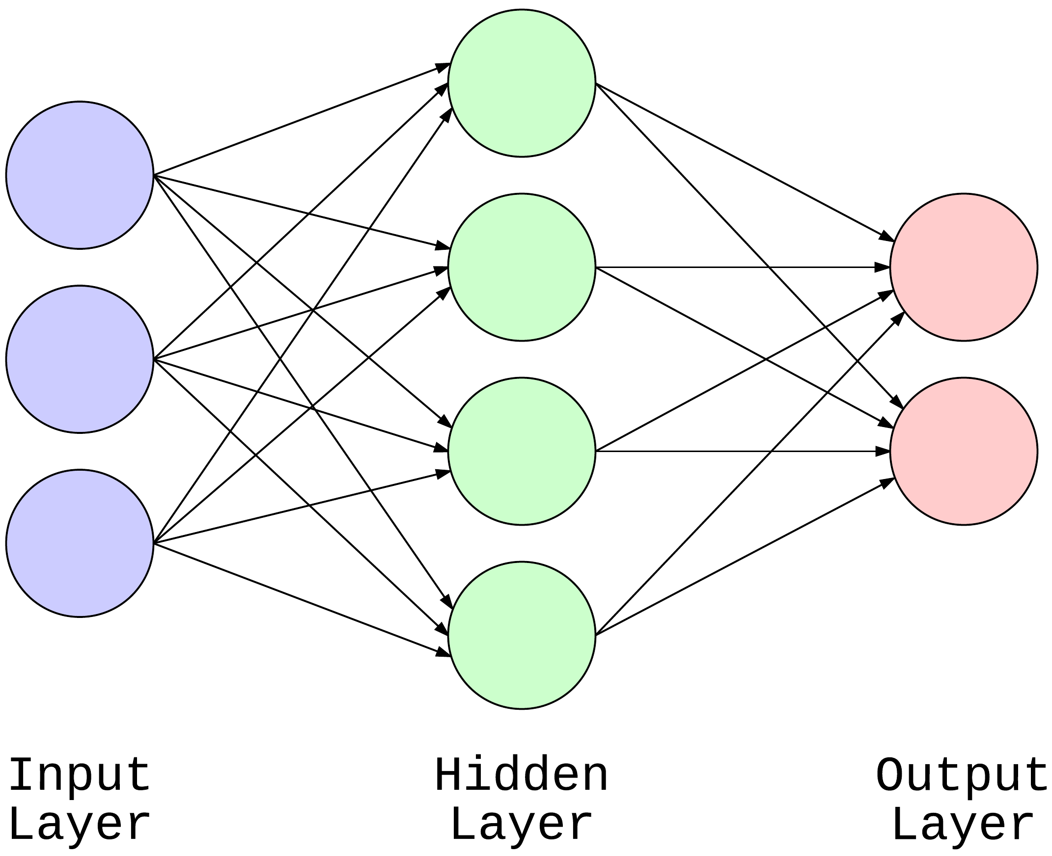
Visualization of a simple 3-layer feedforward artificial neural network

Slide 10
Visualization of a 4-layer neural network that identifies cats!

Slide 11
GPU-Accelerated Computing with CUDA
A parallel programming model

Slide 12
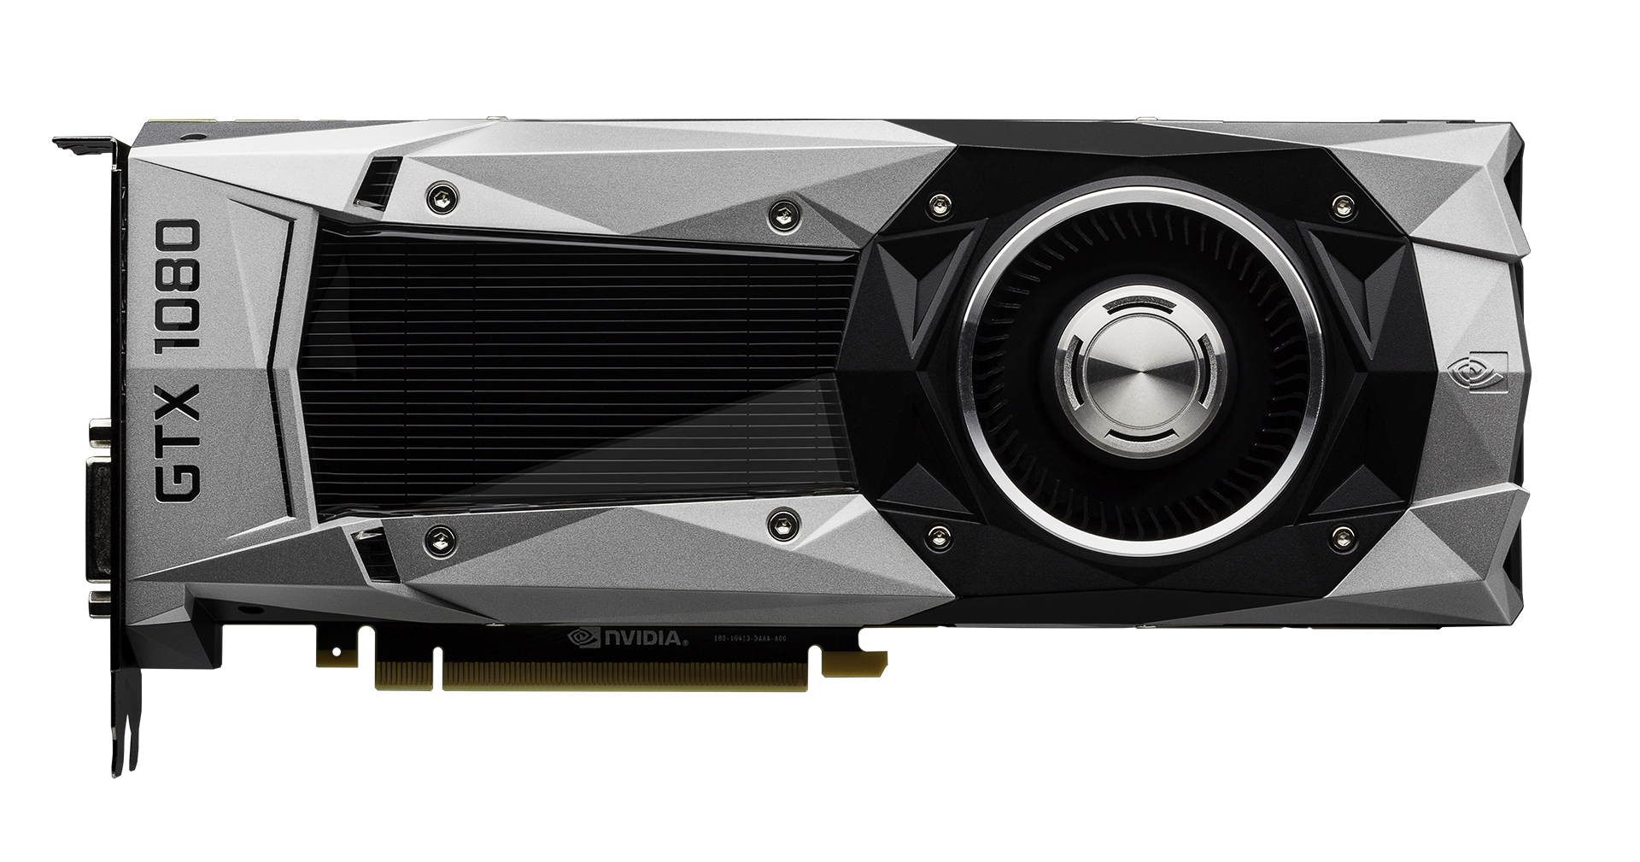
This is a CUDA-enabled GPU device - the GTX 1080

Slide 13
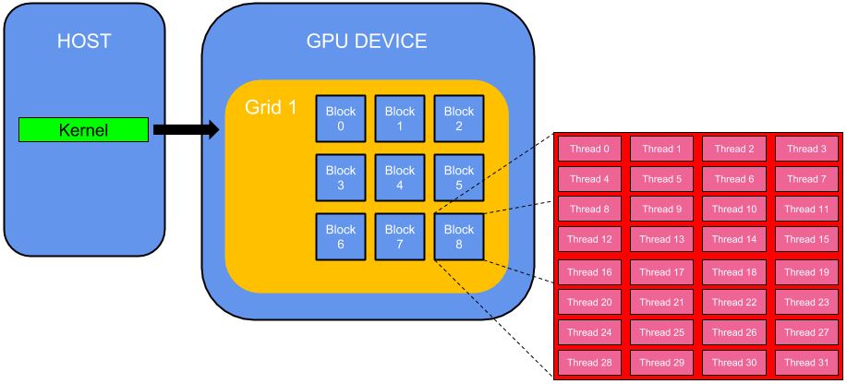
Visualization of a simple 3-layer feedforward artificial neural network

Slide 14
int main(void) {
const int size = 5;
const int a[size] = { 1, 2, 3, 4, 5 };
const int b[size] = { 10, 20, 30, 40, 50 };
int c[size] = { 0 };
// Add vectors sequentially
for (int i = 0; i < size; i++) {
c[i] = a[i] + b[i];
}
}// end main function
A simple C program for adding array elements sequentially.

Slide 15
int main(void) {
const int size = 5;
const int host_a[size] = { 1, 2, 3, 4, 5 };
const int host_b[size] = { 10, 20, 30, 40, 50 };
int host_c[size] = { 0 };
int* dev_a = 0;
int* dev_b = 0;
int* dev_c = 0;
cudaSetDevice(0); // run kernels on GPU 0
// allocate GPU memory for device copies of a, b, c
cudaMalloc((void**)&dev_a, size * sizeof(int));
cudaMalloc((void**)&dev_b, size * sizeof(int));
cudaMalloc((void**)&dev_c, size * sizeof(int));
// copy a and b values from host memory into allocated GPU memory
cudaMemcpy(dev_a, host_a, size * sizeof(int), cudaMemcpyHostToDevice);
cudaMemcpy(dev_b, host_b, size * sizeof(int), cudaMemcpyHostToDevice);
// add array values in parallel (launch 1 block with "size" threads)
kernel_add<<< 1, size >>>(dev_c, dev_a, dev_b);
// copy c values from GPU memory into host memory
cudaMemcpy(host_c, dev_c, size * sizeof(int), cudaMemcpyDeviceToHost);
// free GPU memory once we're done with it
cudaFree(dev_a);
cudaFree(dev_b);
cudaFree(dev_c);
}// end main function
__global__
void kernel_add(int* dev_c,
const int* dev_a,
const int* dev_b ) {
int i = threadIdx.x;
dev_c[i] = dev_a[i] + dev_b[i];
}// end kernel_add cuda kernel
A simple C / CUDA program for adding array elements sequentially.

Slide 16
Neuronmancer (v3)
My research project

Slide 18
MNIST DATASET SAMPLES
28 x 28 = 784 pixels
10 possible classifications
28px
in a single image.
28px
for any given image.

Slide 19
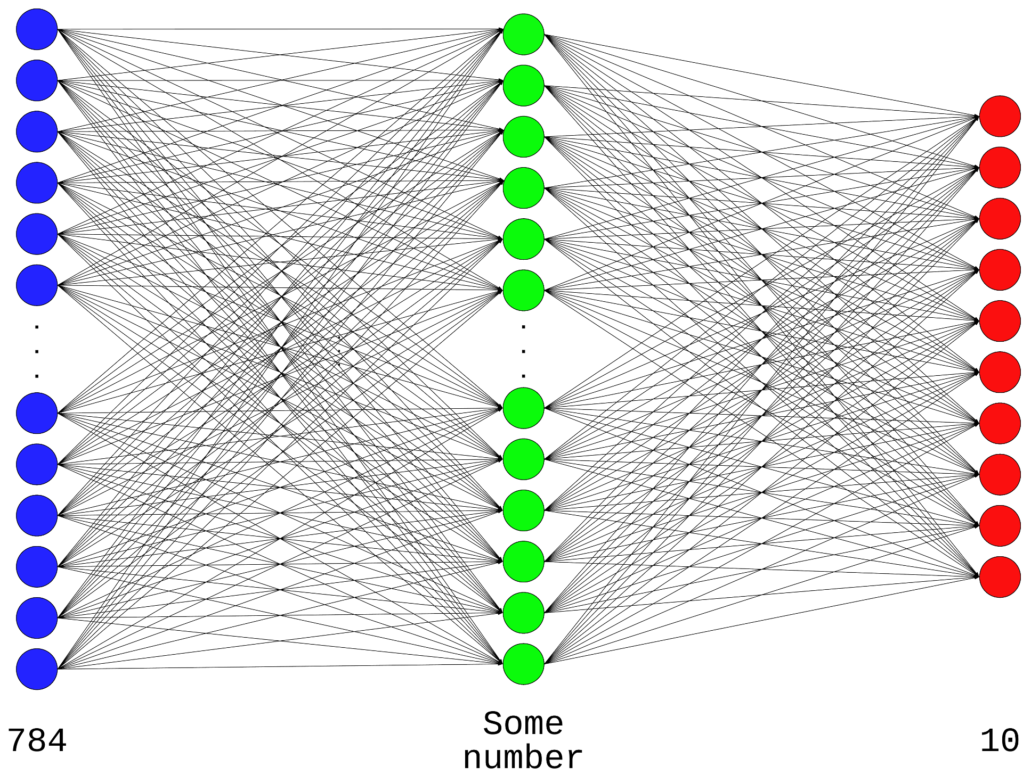
Visualization of neural network models created by my program

Slide 20
MY DATA GATHERING PROCESS
create
model
evaluate
model
train
model
re-evaluate
model

Slide 21
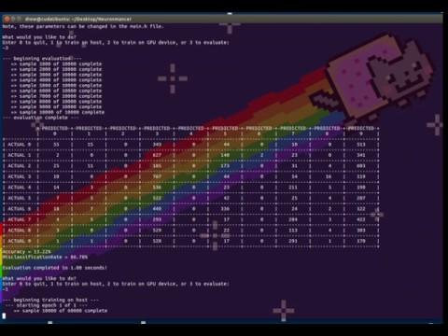

Slide 22
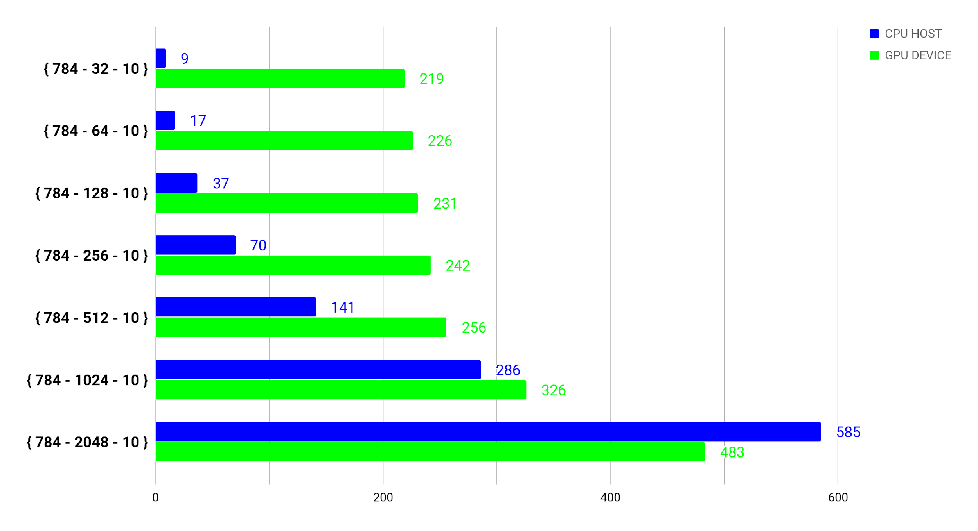
RESULTS (1 of 2)
Intel^{(R)} CoreTM i7-4770K CPU (3.50GHz)_
NVIDIA GeForce GTX 670 (1344 CUDA Cores)_
TRAINING TIMES FOR EPOCH = 1
seconds (lower is better)

Slide 23

RESULTS (2 of 2)
Intel^{(R)} CoreTM i7-4770K CPU (3.50GHz)_
NVIDIA GeForce GTX 670 (1344 CUDA Cores)_
TRAINING TIMES FOR EPOCH = 5
seconds (lower is better)

Slide 24
CHALLENGES
Working with Visual Studio 2015
Learning how to write Makefiles for GNU Make
Learning how CUDA-enabled GPUs work
Learning how to think like a C programmer
... oh, and those two awesome times I spent an entire weekend rewriting Neuronmancer

Slide 25
Acknowledgments
Special thanks to all my friends who encouraged me when I felt like giving up.
Also, to my professors for giving me the freedom to explore a topic I found interesting.

Slide 26

THANKS!
Any questions?
You can find me at:
github.com/DrewHans555
drewhans555@gmail.com
/ / end of presentation

